Slide 1
Basic small group/house churches training

Slide 2
Small Groups are the heartbeat of the Church
The vision should be God – inspired and needed in the world. We take it seriously that God has placed you in as part of this network, and given you a desire to lead others. So we want to help you clarify the vision, then give you an opportunity to pursue it. We are committed to empower and develop you as a leader. [To make a difference]
Your commitment will create life change in individuals and the community, and ensure that it is restored to what God intended it to be.

Slide 3
small Groups/house churches are the heartbeat of the Church
Small gatherings of followers of Christ meeting on their own, facilitated by a leader, are not a new phenomenon. In fact, in the first few hundred years of the Church, these kind of groups were pretty much the only way to experience ‘church’.
Luke describes these types of gatherings in Acts 2:⁴²⁻⁴⁷, and throughout years of church history, the value of these gatherings has not changed.

Slide 4
Connect To God
Establish
2
FULLY DEVOTED FOLLOWERS OF JESUS CHRIST
Mark 12:²⁹⁻³¹
Matt 28:¹⁸⁻²⁰
Discover
1
Grow
3
Connect To the World
Connect To one another
Reach out
4
Connect To Community

Slide 5
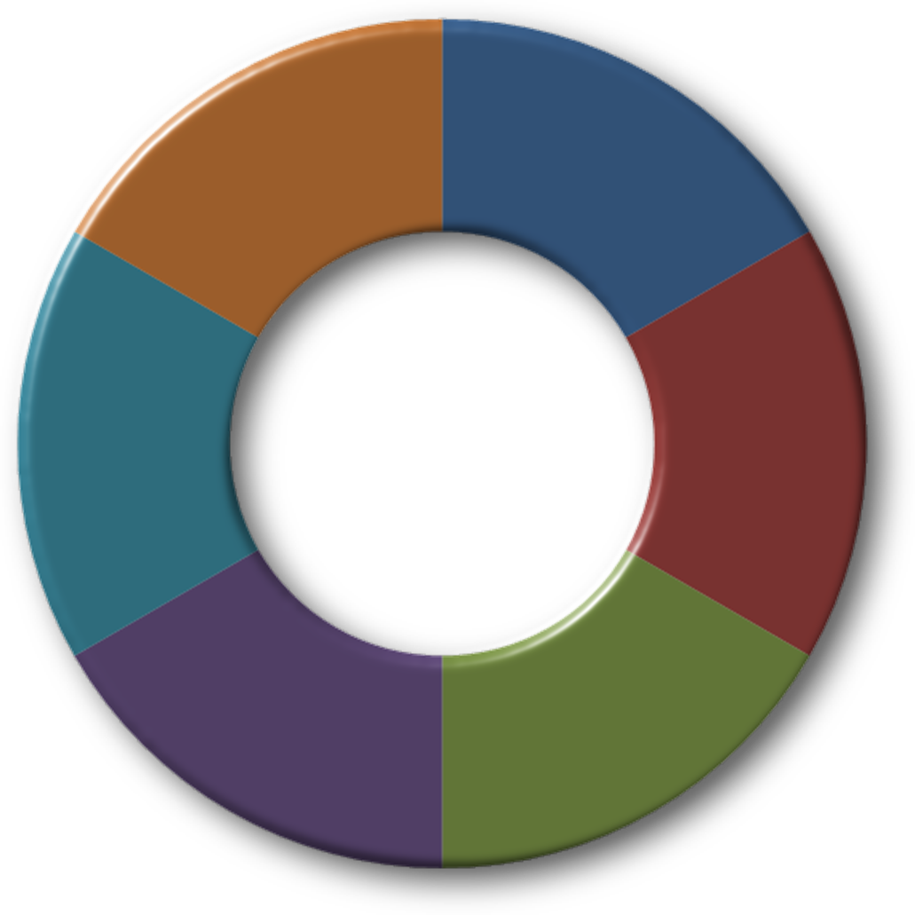
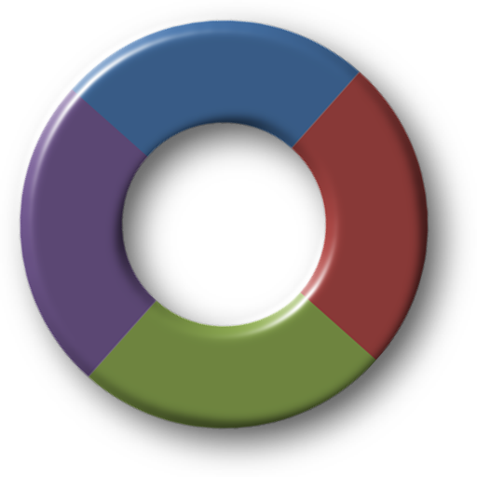
Anatomy of small Groups
Connecting with God
God’s Word
Serving people
Serving people
WORSHIP
EQUIPPING
Prayer
Prayer
NURTURE
To Prosper
Members
Make a difference
Visitors
EMPOWER
EQUIP
Act 2:42
FORM
CARING
People
Impact
DEPLOY
Community
Community
SERVING
OUTREACH
People
Neighbours
Church
Countries

Slide 6
small Groups are the heartbeat DNA of the Church Like the kidneys of our bodies
Relationships
Meaningful relationships develop, and the group figures out how to support and take care of each other.
Growth
All individuals grow . . . to be more of whom God made them to be. This occurs as a result of being around the others in the group.
Community change
Groups influence their community by taking ownership to bring about restoration and change.

Slide 7
How Does My Group Fit into god’s Vision?
Own the vision and direction for your group. Begin by asking yourself these questions:
What kind of group do you want to lead, [Usually like-minded people] relational
What do you want your group to be centered around
What activities will you do
How and when will we multiply the group

Slide 8
How Does My Group Fit into God’s Vision?
Develop people through mentorship
Be there for the group
Maintain your own vibrant spiritual life
Replicate your leadership in others
Support your group when in crisis
People don’t care how much you KNOW, until they know how much you CARE

Slide 9
How Does My Group Fit into God’s Vision?
My goal for being there for my group is:
I will contact _____ members per week
I will spend _____ time with God
I will pray _____ for members

Slide 10
How Does My Group Fit into God’s Vision?
Take ownership of your own development as a leader.
Utilize people and resources designed to enhance growth
Build relationships with other leaders
Existing leaders are one of the greatest resources of support and ideas

Slide 11
How Does My Group Fit into God’s Vision?
These questions may help
What will relationships look like in your group
How do you hope to see people grow because of your group
How will the community be impacted and change because of your group

Slide 12
What does a small Group “Look like”?
Basically, the Group Meeting has 4 Components:
a. Connecting: With each other and then with God. A time at the beginning of the meeting to talk and get acquainted, followed by a time for Praise & Worship to prepare our hearts for His Word. (15-20 min.)

Slide 13
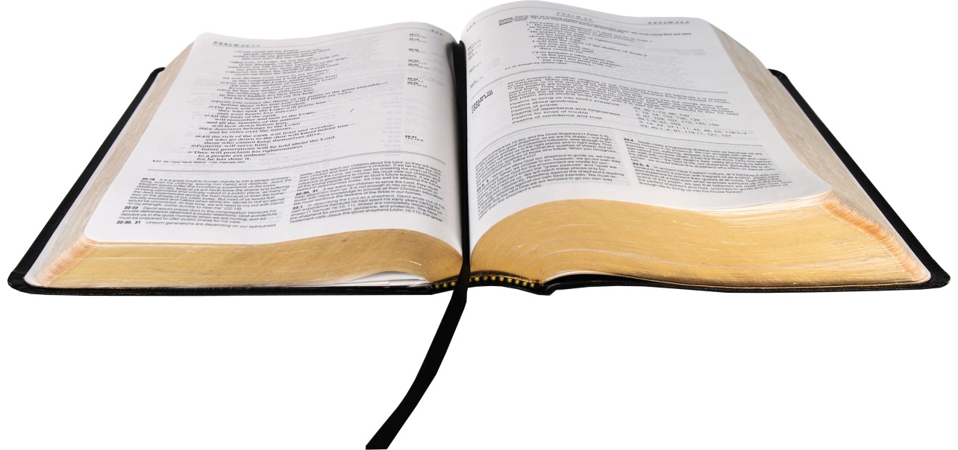
What does a Konnekt Group “Look like”?
b. Studying: Discussion and application of the Bible, and the Word during weekly service to our daily lives. (30 min.)

Slide 14
What does a small Group “Look like”?
c. Sharing: Talking about our challenges, needs, joys, and sorrows in the journey of life. Thus encourage and edify

Slide 15
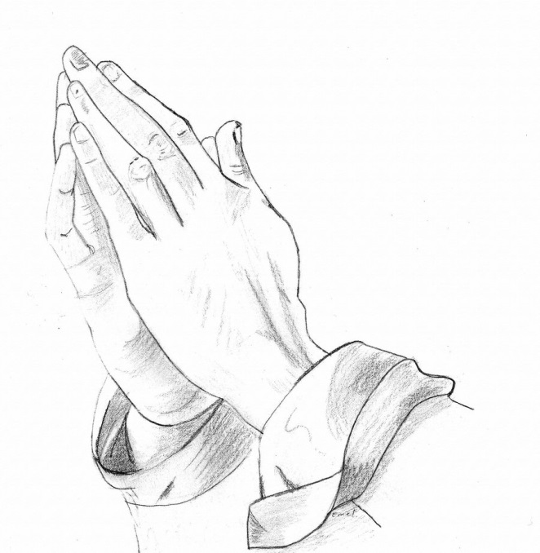
What does a small Group “Look like”?
d. Praying: Giving and receiving prayer, support, and encouragement for the things that have been shared with the group. (15-20 min)

Slide 16
3. What is the Group Leader’s Role?
The Group Leader’s Role has 3 Components:
a. Leading:
Casting Vision
Planning & Facilitating Meetings
Ensuring Group Development: Fellowship, Care / Prayer, Growth, & Outreach.
Activate and Mobilise

Slide 17
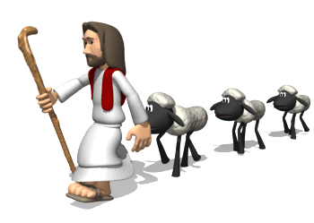
3. What is the Group Leader’s Role?
b. Shepherding:
1. Providing Care and Prayer for Group Members & Visitors
2. Ensuring Group Members create a practical Growth Plan

Slide 18
3. What is the Group Leader’s Role?
c. Administrating:
If Refreshments are provided for each meeting, involve the group
Visitor Follow-up: Call between meetings to encourage.
Reporting: Take Attendance at each meeting and send in Weekly Report.
NOTE: It is recommended that the Leader utilize others appropriately gifted within the group to help accomplish the above list of tasks.

Slide 19
3. What is the Group Leader’s Role?
2. Visitor Follow-up: Call between meetings to encourage.

Slide 20
FINANCES
PLANS
DREAMS
The
CAUSE
Jesus Christ
SOULS
TIME
LIFE
MARRIAGE
RESOURCES

Slide 21
“People don’t CARE how much you KNOW, until they KNOW how much you CARE”
Go & BE the Difference

